Slide 1









Common Type System
.NET Types Hierarchy, Cloning, Comparing, Collection Iterators, Value and Reference Types
SoftUni Team
Technical Trainers
Software University
http://softuni.bg

Slide 2


Table of Contents
What is Common Type System (CTS)?
The System.Object type
Operators is and as
Object Cloning
The IComparable<T> Interface
The IEnumerable<T> interface
Value Types and Reference Types
Passing Parameters: in, out, ref

Slide 3

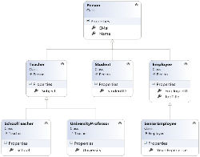
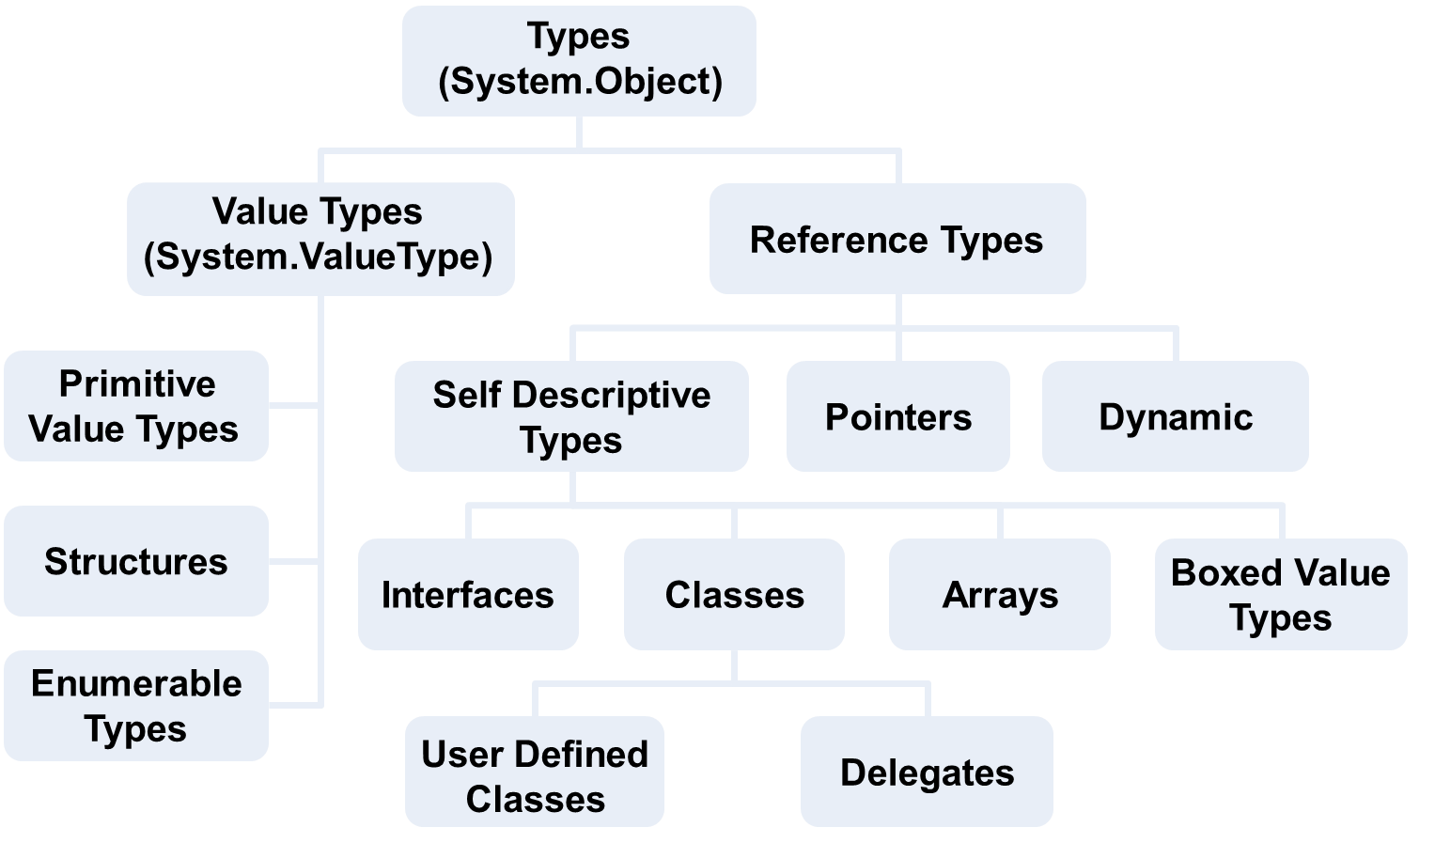
What is Common Type System (CTS)?

Slide 4
Inside .NET Framework
Building blocks of .NET Framework
C#
VB.NET
C++
F#
…
ASP.NET
Web Forms, MVC, Web API, SignalR
Windows
Forms
WPF / XAML
WinJS / Win8
FCL
ADO.NET, EF, LINQ and XML (Data Tier)
Base Class Library (BCL)
CLR
Common Language Runtime (CLR)
Operating System (OS)

Slide 5
What is CTS?
.NET Common Type System (CTS)
Defines CLR supported:
Data types (e.g. Int32, String, dynamic)
Operations performed on them, e.g. +, -, []
Extends the compatibility between different .NET languages
Supports two types of data
Value types (values), e.g. 20, true, 'a'
Reference types (pointers to the heap), e.g. strings and arrays
All data types are inheritors of System.Object

Slide 6
.NET CTS Types Hierarchy
Types
(
System
.
Object
)
Value Types
(
Reference Types
System
.
ValueType
)
Primitive
Self Descriptive
Value Types
Pointers
Dynamic
Types
Structures
Boxed Value
Interfaces
Classes
Arrays
Types
Enumerable
Types
User Defined
Delegates
Classes

Slide 7
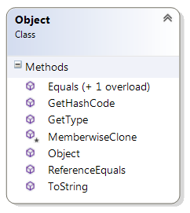


The System.Object Type
The Parent of All .NET Types

Slide 8
System.Object Type
System.Object is the base class for each .NET type
Inherited by default when a new type is defined
Important virtual methods:
Equals() – comparison with other objects
ToString() – represents the object as a string
GetHashCode() – evaluates the hash code (used with hash-tables)

Slide 9

Overriding the Virtual Methods in System.Object

Slide 10
Overriding System.Object's Virtual Methods
By default the operator == calls ReferenceEquals()
Compares the addresses for reference types
Or the binary representation for value types
The methods Equals(), GetHashCode() should be defined at the same time
The same applies for the operators == and !=
You can override Equals() and use it for == and !=

Slide 11
Overriding System.Object Methods – Example
public class Student
{
public string Name { get; set; }
public int Age { get; set; }
public override bool Equals(object param)
{
// If the cast is invalid, the result will be null
Student student = param as Student;
// Check if we have valid not null Student object
if (student == null)
return false;
// Compare the reference type member fields
if (!Object.Equals(this.Name, student.Name))
return false;
// Compare the value type member fields
if (this.Age != student.Age)
return false;
return true;
}
// the example continues

Slide 12
Overriding System.Object Methods – Example (2)
public static bool operator == (Student student1, Student student2)
{
return Student.Equals(student1, student2);
}
public static bool operator != (Student student1, Student student2)
{
return !(Student.Equals(student1, student2));
}
public override int GetHashCode()
{
return Name.GetHashCode() ^ Age.GetHashCode();
}
}

Slide 13
Overriding ToString()
Classes can override the virtual ToString() method
public class Student
{
public string Name { get; set; }
public int Age { get; set; }
public override string ToString()
{
return string.Format("Student: {0}, Age: {1}",
this.Name, this.Age);
}
}

Slide 14
Overriding the Virtual Methods in System.Object
Live Demo

Slide 15
More About System.Object
The System.Object type has some other methods, which are inherited by all .NET types:
GetType()
Returns the type's metadata as a System.Type
MemberwiseClone()
Copies the binary representation of the variable into a new variable (shallow clone)
ReferenceEquals()
Compares if two object have the same reference

Slide 16

is and as Operators
as
is

Slide 17

Type Operators in C#
The is operator
Checks if an object is an instance of a given type
Polymorphic operation
5 is Int32
5 is object
5 is IComparable<int>
The as operator
Casts a reference type to another reference type
Returns null value if it fails, e.g. if the types are incompatible

Slide 18
Operators is and as – Example
class Shape { }
class Triangle : Triangle { }
class TestOperatorsIsAndAs
{
static void Main()
{
Object objBase = new Shape();
if (objBase is Shape)
Console.WriteLine("objBase is Shape");
// Result: objBase is Shape
if (! (objBase is Triangle))
Console.WriteLine("objBase is not Triangle");
// Result : objBase is not Triangle
if (objBase is System.Object)
Console.WriteLine("objBase is System.Object");
// Result : objBase is System.Object
// the example continues

Slide 19
Operators is and as – Example (2)
Shape b = objBase as Shape;
Console.WriteLine("b = {0}", b);
// Result: b = Shape
Triangle d = objBase as Triangle;
if (d == null)
Console.WriteLine("d is null");
// Result: d is null
Object o = objBase as object;
Console.WriteLine("o = {0}", o);
// Result: o = Shape
Triangle der = new Triangle();
Shape bas = der as Shape;
Console.WriteLine("bas = {0}", bas);
// Result: bas = Triangle
}
}

Slide 20

Operators is and as
Live Demo

Slide 21

Object Cloning

Slide 22
Object Cloning
In programming cloning an object means to create an identical copy of a certain object
Shallow cloning (shallow copy)
Uses the protected MemberwiseClone() method
Copies the value types bit by bit (binary)
Copies only the addresses of the reference types
Deep cloning (deep copy)
Recursively copies all member data
Implemented manually by the programmer

Slide 23
Object Cloning (2)
Types which allow cloning should implement the ICloneable interface
The Clone() method in ICloneable
The only method of the interface
Returns an identical copy of the object
Returns object → must be cast later
You decide whether to create a deep or a shallow copy or something mixed

Slide 24
Object Cloning – Example
class LinkedList<T> : ICloneable
{
public T Value { get; set; }
public LinkedList<T> NextNode { get; private set; }
public LinkedList(T value, LinkedList<T> nextNode = null)
{
this.Value = value;
this.NextNode = nextNode;
}
object ICloneable.Clone() // Implicit implementation
{
return this.Clone();
}
// the example continues

Slide 25

Object Cloning – Example (2)
public LinkedList<T> Clone() // our method Clone()
{
// Copy the first element
LinkedList<T> original = this;
T valueOriginal = original.Value;
LinkedList<T> result = new LinkedList<T>(valueOriginal);
LinkedList<T> copy = result;
original = original.NextNode;
// Copy the rest of the elements
while (original != null)
{
valueOriginal = original.Value;
copy.NextNode = new LinkedList<T>(valueOriginal);
original = original.NextNode;
copy = copy.NextNode;
}
return result;
}

Slide 26

Deep and Shallow Object Cloning
Live Demo

Slide 27

The IComparable<T> Interface
Comparing Objects

Slide 28

IComparable<T> Interface
The System.IComparable<T> interface
Implemented by the types, which can be compared (ordered in increasing order)
The CompareTo(T) method should return:
Number < 0 – if the passed object is bigger than this object
Number = 0 – if the passed object is equal to this object
Number > 0 – if the passed object is smaller than this object

Slide 29
IComparable<T> – Example
class Point : IComparable<Point>
{
public int X { get; set; }
public int Y { get; set; }
public int CompareTo(Point otherPoint)
{
if (this.X != otherPoint.X)
{
return (this.X - otherPoint.X);
}
if (this.Y != otherPoint.Y)
{
return (this.Y - otherPoint);
}
return 0;
}
}

Slide 30
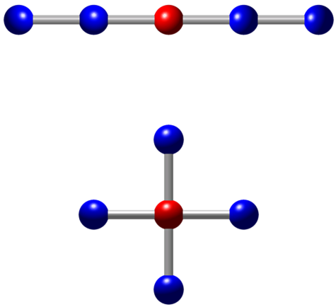
Implementing IComparable<T>
Live Demo

Slide 31

Exercise in Class

Slide 32

The IEnumerable<T> Interface
Iterators and Foreach

Slide 33
IEnumerable<T>
The IEnumerable<T> interface provides collection classes with foreach traversal
It consists of 4 interfaces: IEnumerable<T>, IEnumerable, IEnumerator<T>, IEnumerator
public interface IEnumerable<T> : IEnumerable
{
IEnumerator<T> GetEnumerator();
}
// Non-generic version (compatible with the legacy .NET 1.1)
public interface IEnumerable : IEnumerable
{
IEnumerator GetEnumerator();
}

Slide 34
IEnumerator<T>
IEnumerator<T> provides sequential read-only, forward-only iterator (see Iterator Design Pattern)
public interface IEnumerator<T> : IEnumerator
{
bool MoveNext();
void Reset();
T Current { get; }
}
public interface IEnumerator
{
bool MoveNext();
void Reset();
object Current { get; }
}

Slide 35
Yield Return in C#
The yield return construct in C# simplifies the IEnumerator<T> implementations
When a yield return statement is reached
The expression is returned, and the current element is retained (to resume later)
public IEnumerator<int> GetEnumerator()
{
for (int i = 100; i < 200; i++)
{
yield return i;
}
}

Slide 36
Implementing IEnumerable<T>
Live Demo

Slide 37

Value Types
Values Staying in the Execution Stack

Slide 38
Value Types
Stored directly in the program execution stack
Cannot hold null value
Passed by value (by copy) when a method is called
Destroyed when the variable goes out of scope
Inherit from System.ValueType
Value types are:
Primitive types (int, char, float, bool)
Structures (e.g. DateTime)
Enumerations

Slide 39
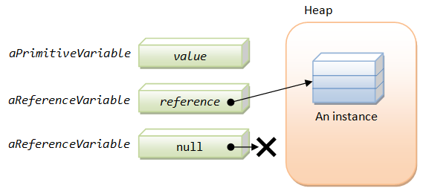
Reference Types
Pointers to Objects in the Heap

Slide 40
Reference Types
Implemented as type-safe pointers to objects
Stored in the dynamic memory (managed heap)
Can hold null value
When a method is called – passed by reference (by address)
Destroyed by the garbage collector when not used
Many variables can point to the same object
Reference objects are:
System.Object, System.String, classes and interfaces, arrays, delegates, pointers, dynamic objects

Slide 41

Value vs. Reference Types
reference types
value types
Assigning, Memory Location and Values

Slide 42
Process Memory
Each Windows process is assigned its own memory area
The stack holds called methods and their local variables
Has fixed size (cannot grow)
Each thread is granted its own stack
The heap holds dynamically allocated objects during execution
Can dynamically grow
Shared between all threads
int
new Thread()
"hello"
Stack
Heap
long
new FileStream()
bool
new Person()
Program.exe memory

Slide 43
Value vs. Reference Types
Value types and reference types behave differently
When assigning value types, their value is copied to the variable
When assigning reference type, only the reference (address) is copied and the object stays the same
Memory location
Value types stay in the program execution stack
Reference types stay is the dynamic memory (managed heap)

Slide 44
Value vs Reference Types (2)
Value types cannot take null as a value
Because they are not pointers (addresses)
Value types inherit System.ValueType
Reference types inherit System.Object
Value type variables can be stored in reference type variables through a technique called "boxing"

Slide 45
Value and Reference Types – Example
class Student { public int age; } // Reference type
struct Number { public int value; } // Value type
class TestValueAndReferenceTypes
{
static void Main()
{
Student pesho = new Student();
pesho.age = 100;
Student gosho = pesho;
gosho.age = 200;
Console.WriteLine(pesho.age); // Prints 200
Number num1 = new Number();
num1.value = 100;
Number num2 = num1;
num2.value = 200;
Console.WriteLine(num1.value); // Prints 100
}
}

Slide 46
Stack Variable Allocation
Value types' values are directly pushed onto the stack
Reference types have their pointer pushed onto the stack
int a = 5;
00E525B3 mov dword ptr [ebp-3Ch],5
int b = 41;
00E525BA mov dword ptr [ebp-40h],29h
string name = "Pesho";
00E525C1 mov eax,dword ptr ds:[39021F0h]
00E525C7 mov dword ptr [ebp-44h],eax
Stack
Variable | Address | Value
ebp (stack start) | … | …
a | 0xBA2A1A01 | 5
b | 0xBA2A1AFD | 41
name | 0xBA2A1AF9 | eax
(free stack memory) | … | …
(stack end) | 0x00000000 | …

Slide 47
Types, Variables and Memory
Program execution stack
Dynamic memory (managed heap)
Variable
Address
Value
Address
Value
...
...
(stack start)
...
...
...
...
class1
0x0012F680
0x04A41A44
class2
0x0012F67C
0x04A41A44
0x04A41A44
"Pesho"
struct1
0x0012F678
100
...
...
struct2
0x0012F674
200
...
...
(free stack memory)
...
...
...
...
(stack end)
0x00000000
...
...
...

Slide 48

Value and Reference Types
Live Demo

Slide 49



Boxing and Unboxing
Keeping Value Types in Objects

Slide 50


Boxing and Unboxing
Value types can be stored in reference types
Boxing and unboxing is done automatically in .NET
Boxing == converting a value type to a boxed reference one
Unboxing == converting boxed value to a value type

Slide 51

Boxing: How It Works
Allocates dynamic memory for the boxed object
A new object in the managed heap
Copies the value of the value-type variable
From the stack to the boxed object
Returns a reference to the boxed object
The original value type is stored as part of the boxed object

Slide 52

Unboxing: How It Works?
If the reference is null
A NullReferenceException is thrown
If the reference does not hold a valid boxed value
An InvalidCastException is thrown
The value is pulled from the heap
Stored into the stack in a value-type variable

Slide 53
Boxing Value Types
Stack
Heap
int i=5;
obj
i=5
(value-type
variable in
the stack)
object obj = i;
5
(boxing)
(boxed
value-type
variable
in the heap)
i2=5
(value-type
variable in
the stack)
int i2;
i2 = (int) obj;
(unboxing)

Slide 54
Boxing and Unboxing – Example
class TestBoxingUnboxing
{
static void Main()
{
int value1 = 1;
object obj = value1; // boxing performed
value1 = 12345; // only stack value is changed
int value2 = (int)obj; // unboxing performed
Console.WriteLine(value2); // prints 1
long value3 = (long) (int) obj; // unboxing
long value4 = (long) obj; // InvalidCastException
}
}

Slide 55

Boxing and Unboxing Primitive Types
Live Demo

Slide 56
Boxing and Unboxing – Example
interface IMovable
{
void Move(int x, int y)
}
// Bad practice! Structures should hold no logic, but only data!
struct Point : IMovable
{
public int x, y;
public void Move(int x, int y)
{
this.x += x;
this.y += y;
}
}

Slide 57

Boxing and Unboxing Custom Types
Live Demo

Slide 58

Passing Parameters
ref and out Keywords

Slide 59

Passing Parameters: In, Out and Ref
Parameters can be passed in several ways to methods:
in (default)
Passed by value for value types
Passed by address for reference types
out
Passed by stack address for both value types and reference types
ref
Passed by stack address for both value types and reference types

Slide 60
ref Parameters – Example
public class Student
{
public string name;
static void IncorrectModifyStudent(Student student)
{
student = new Student("Changed: " + student.name);
}
static void ModifyStudent(ref Student student)
{
student = new Student("Changed: " + student.name);
}
static void Main()
{
Student s = new Student("Nakov");
Console.WriteLine(s.name); // Nakov
IncorrectModifyStudent(s);
Console.WriteLine(s.name); // Nakov
ModifyStudent(ref s);
Console.WriteLine(s.name); // Changed: Nakov
}
}

Slide 61

ref Parameters
Live Demo

Slide 62
out Parameters – Example
class TestOutParameters
{
static void Main()
{
Rectangle rect = new Rectangle(5, 10, 12, 8);
Point location;
Dimensions dimensions;
// Location and dimension are not pre-initialized!
rect.GetLocationAndDimensions(out location, out dimensions);
Console.WriteLine("({0}, {1}, {2}, {3})",
location.x, location.y, dimensions.width, dimensions.height);
// Result: (5, 10, 12, 8)
}
}

Slide 63

out Parameters
Live Demo

Slide 64

Summary
The Common Type System (CTS) defines the data types in .NET
System.Object is the base type for all .NET types
Object cloning copies the object data
Provided by ICloneable<T>
IComparable<T> defines object comparison
IEnumerable<T> defines an iterator over the elements of the object (foreach support)
Value types hold values in the stack, passed by value
Reference types hold value in the heap + address in the stack

Slide 65









OOP – Common Type System
https://softuni.bg/courses/oop/

Slide 66
License
This course (slides, examples, demos, videos, homework, etc.) is licensed under the "Creative Commons Attribution-NonCommercial-ShareAlike 4.0 International" license
Attribution: this work may contain portions from
"OOP" course by Telerik Academy under CC-BY-NC-SA license

Slide 67





Free Trainings @ Software University
Software University Foundation – softuni.org
Software University – High-Quality Education, Profession and Job for Software Developers
softuni.bg
Software University @ Facebook
facebook.com/SoftwareUniversity
Software University @ YouTube
youtube.com/SoftwareUniversity
Software University Forums – forum.softuni.bg

